Slide 1
E-Voting in Austria
Current Status and Recent Developments
Bi-Annual E-Voting Review, Madrid Robert Krimmer
16th of October, 2008

Slide 2
„I am in favor of voting via electronic means. We will look at the Student Council Elections with E-Voting in May 2009 and then look how we can implement that for out-of-country voting for Austrians abroad!“
State Secretary Hannes Winkler, Salzburg 6.9.2008

Slide 3
Preparations
E-Voting Review Meeting Council of Europe, Nov 2006:
Need for structured overview of experiences with electronic voting.
Start of DB.E-Voting.CC project
=> Documentation of 200+ uses of electronic means in elections world-wide
October 08
Building knowledge on the future of voting
3

Slide 4
The Database
October 08
Building knowledge on the future of voting
4
Access data: Country Data http://db.e-voting.cc/DE Top-level-domain
Edit data: Anyone, anytime – Wiki-style!
Enter data: Use wiki-style editing to add data

Slide 5
Environment
Analyse and compare the environment for the introduction of E-Voting.
Contextual model was developed and
Applied with the value benefit analysis to compare
Evaluation of all EU member states and Russia, Switzerland, the United States, and Venezuela.

Slide 6
E-Voting Readiness Index

Slide 7
Legal Context
1923 | Introduction of voting cards (for „other“ polling places)
1949 | Introduction of voting in „institution precincts“
1984 | Introduction of voting before „flying electoral commissions“
1990 | Introduction of voting from abroad (for Austrian expatriates and Austrian citizens abroad on e-day)
1998 | Facilitation of voting from abroad (only 1 witness)
2007 | Introduction of real postal voting; subscription of voting cards for expatriates

Slide 8
Information Society
Central Citizen Register since 2001
National ID Card (Citizen Card)
Trust Center
(digital
Certificate)
Central
Citizen Register
(ZMR)
Certificate ZMR-#

Slide 9
E-Voting in Austria
2000: First Idea to talk about E-Voting in Student Council
2001: Laws passed for Student Council and Chamber of Commerce
2004: Inter-departmental Working Group for E-Voting headed by Ministry of Interior – Legal, Technical, and International
2007: Minister for Science picks up E-Voting for Student Union

Slide 10
Student Council
National body for representing students
Legal corporation by public law
Installed at all 21 universities
240.000 members
Bi-annual elections
Voter turnout ~ 30 %
Two E-Voting shadow elections in 2003 and 2004
High tension around e-voting

Slide 11
Student Council
Next Election: May 2009
Paper-Based Voting Tuesday to Thursday
Additional Channel: Internet Voting Monday 8.00 to Friday 18.00
Identification using Citizen ID Card
Need for support action to raise number of students having Citizen ID Card => www.studi.gv.at
Election Observation main focus
October 08
11

Slide 12
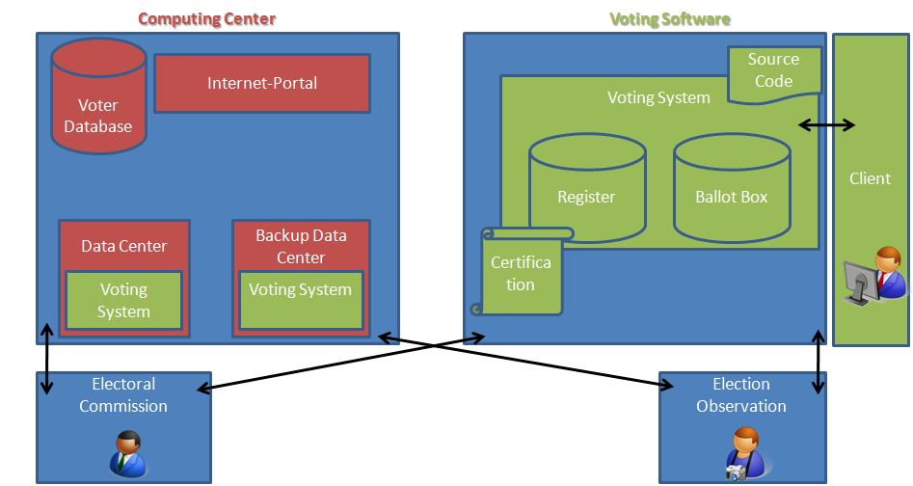
Overview

Slide 13
Overview
Introduction of Postal Voting first step
Student Council Election in May 2009
Using Citizen Card
One week before paper based election
After Student Council Election Review and Assessment

Slide 14
Contact
Robert Krimmer
Competence Center for Electronic Voting and Participation
Pyrkergasse 33/1/2
A-1190 Wien
Tel.: +43 1 3193950
Fax: +43 1 3193955
E-Mail: office@e-voting.cc
Web: www.e-voting.cc

