Slide 1
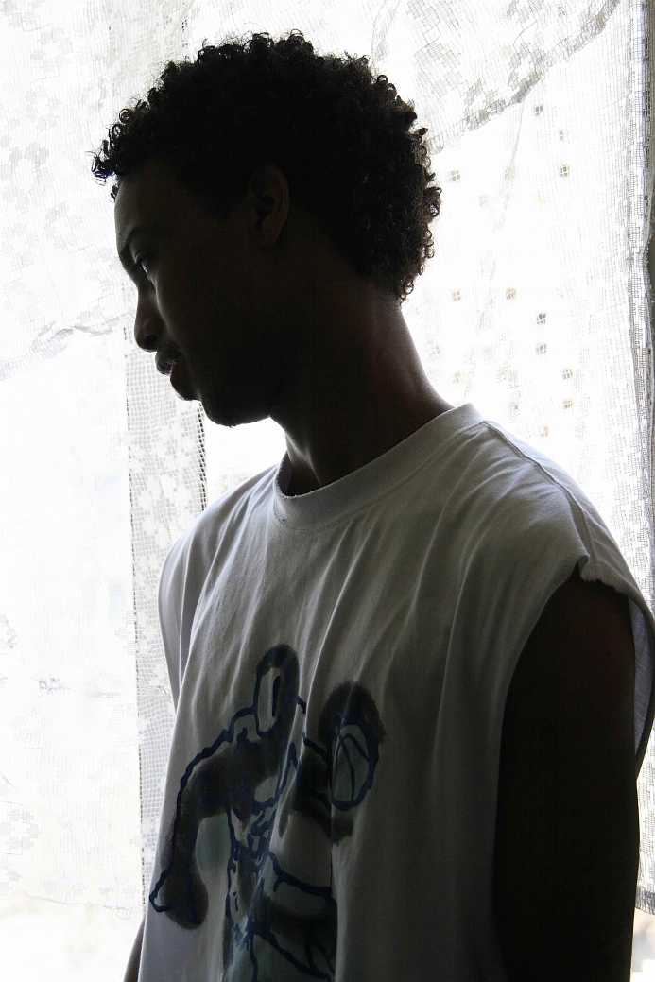
The detention of unaccompanied minor
asylum seekers
in Ukraine
Photo courtesy of Aleksandr Bezobchuk
Danish Refugee Council implements the project funded by the European Union under the EU Regional Protection Programme, “Legal and Social Protection of Asylum Seeking and Refugee Children in Ukraine, Belarus and Moldova.”

Slide 2
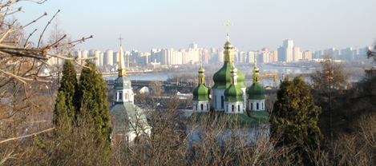
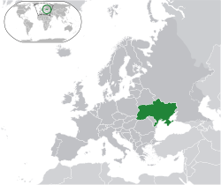
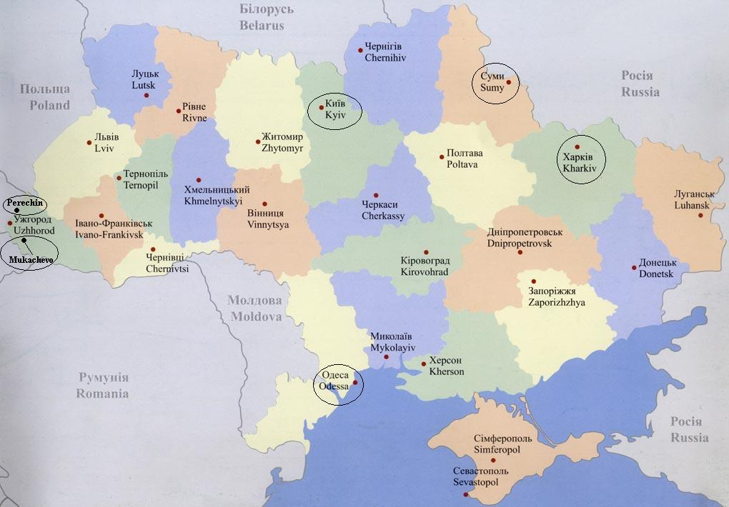

Slide 3
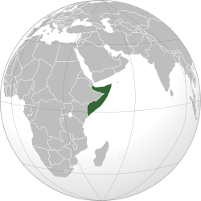
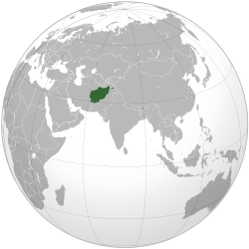
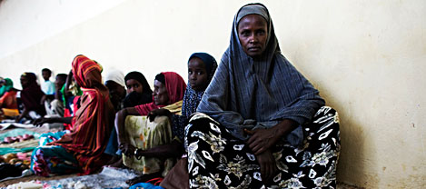
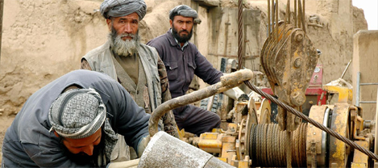
Unaccompanied minor asylum seekers in Ukraine
54% Somalis
37% Afghans
9% from elsewhere
(Syria, Egypt, and
sub-Saharan Africa)
Statistics: Unaccompanied minor asylum seekers in Ukraine | Source: DRC/UNHCR/NGO (19 June 2012) | Source: State Migration Service (19 June 2012)
Total | 134 | “Clarifying NGO statistics”
Countries of Origin/ Gender breakdown | 49 – Afghanistan (all male) 73 – Somali (56 male, 17 female) 03 – Eritrea (all male) 02 – Guinea (1 male, 1 female) 07 – DR Congo, Ethiopia, Côte d'Ivoire, Syria, Egypt, Sierra Leone

Slide 4
Unaccompanied minor asylum seekers in Ukraine
62% of unaccompanied minor applicants are Somalis
33% of unaccompanied minor applicants are Afghans
5% from elsewhere
Statistics: Unaccompanied minor asylum seekers in Ukraine | Source: DRC/UNHCR/NGO (19 June 2012) | Source: State Migration Service (19 June 2012)
Total | 129 | *
In asylum procedures | 55 | 50
In appeals procedures | 5 | No statistics

Slide 5
Detained unaccompanied minor asylum seekers in Ukraine
Photo courtesy of IOM Mission to Ukraine
Statistics: Detained unaccompanied minors in Ukraine | Source: DRC/UNHCR/NGO (31 May 2012) | Source: State Migration Service (31 May 2012)
Chernigiv MAC | 8 | 0
Volyn MAC | 12 | 0
Total | 20 | 0
Country of Origin | Male | Female | Total
Eritrea | 1 |  | 1
Guinea | 1 | 1 | 2
Somalia | 12 | 5 | 17
Total | 14 | 6 | 20

Slide 6
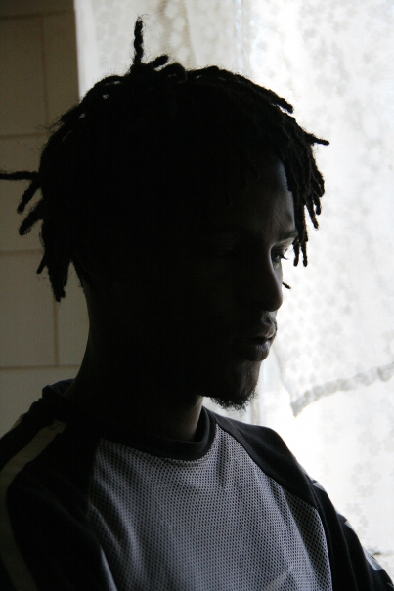
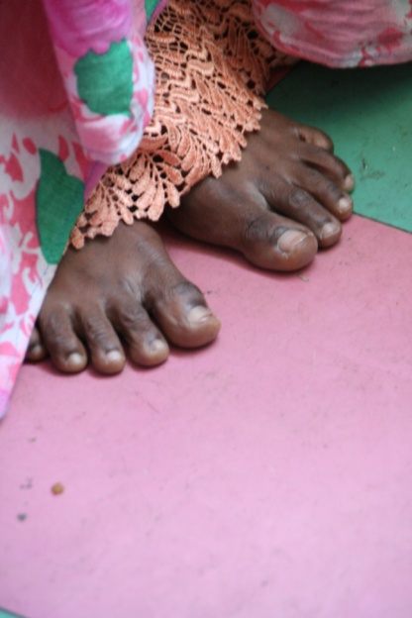
Conditions contributing to the detention of unaccompanied minor asylum seekers in Ukraine
I. State Migration Service new policy not to release detainees upon asylum application (since end of 2011)
Photo courtesy of Aleksandr Bezobchuk
II. Detention by court order for those not in asylum procedures, however abnormalities in proceedings
III. Age-assessment procedure required by new law on refugees (July 2011), but not yet devised
Photo courtesy of Aleksandr Bezobchuk
IV. Inter-agency instructions on the identification and reception of unaccompanied minors still to be finalized

Slide 7
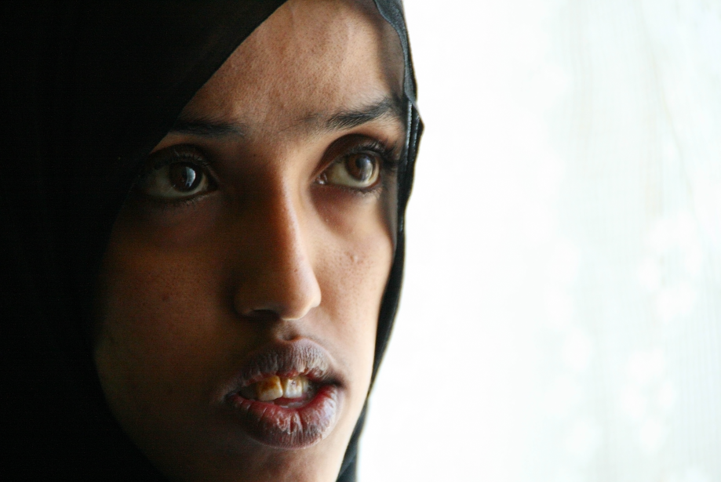
Thank you for your attention!
Krista Zongolowicz, Country Director
krista.zongolowicz@drc.dk
Telephone +38 0 44 279 1144
Danish Refugee Council, Ukraine
drc.ukraine@drc.dk www.drc.dk
http://www.facebook.com/DatskijSovet

