Slide 1


Slide 2

Council of Europe Higher Education Programme 2025
Catherine Dolgova-Dreyer, Head of Higher and Further Education
2

Slide 3
46 MEMBER STATES
700 MILLION EUROPEANS
Lisbon Recognition Convention
LRC Committee meeting – in October 2025 (hosted by UNESCO)
Adoption of the revised Code of Good Practice in the provision of transnational education
Revision of the ENIC – NARIC Charter
New Bureau Workplan:
- strengthening cooperation between the regional recognition conventions;
developing a subsidiary text on digital solutions, including considerations related to artificial intelligence and recognition;
research and monitoring, with a particular focus on the concept of ‘substantial differences’.

Slide 4

46 MEMBER STATES
700 MILLION EUROPEANS
Recognition of refugee's qualifications
CM Recommendation on qualifications and linguistic competences of refugees
European Qualifications Passport for Refugees : survey published
24 countries
Presidency event in the Republic of Moldova – 28 April 2026

Slide 5

46 MEMBER STATES
700 MILLION EUROPEANS
Portraits of Refugees
Portraits of Refugees, published by the Council of Europe in 2025
Unique stories of seven displaced students and professionals who have been rebuilding their lives in CoE member states, highlighting the resilience and contributions of refugees
EQPR as a key tool for access to education and employment
Insight into individuals’ trajectories complements recent survey on the use and impact of the EQPR

Slide 6

46 MEMBER STATES
700 MILLION EUROPEANS
Artificial intelligence in higher education
Artificial Intelligence and recognition of qualifications
Three-year programme on Artificial Intelligence
and Recognition of Qualifications
The WG established (1st meeting in October 2025)
Survey (to ENIC-NARIC centres, HEIs and ministries) to map the current/future usage of AI tools in recognition workflows
Further work - guidelines and a self-learning module for credential evaluators, admission officials and other relevant stakeholders, based on the HUDERIA model developed by the Committee on Artificial Intelligence of the CoE. Risk and impact assessment of AI tools from a human rights perspective.

Slide 7
46 MEMBER STATES
700 MILLION EUROPEANS
Automatic Recognition
At its plenary meeting in September 2025 the CDEDU approved the proposal to draft a Convention on the Conditions of Transparency and Quality Assurance for Automatic Recognition of Higher Education Qualifications in Europe, based on the results of the activities and core content developed by the Ad Hoc WG
The proposal for this new legal instrument and the draft Terms of Reference of a Committee of Experts will be submitted to the CM in January 2026. If endorsed, the Drafting committee will prepare the text and its explanatory report by late 2026

Slide 8

46 MEMBER STATES
700 MILLION EUROPEANS
ETINED (Ethics, Integrity and Transparency in Education) Platform
Mission:
Share information and good practices in the field of ethics, transparency and integrity in education;
Contribute to the development of adequate answers to challenges that corruption poses to the sector of education and higher education;
Create a virtuous cycle in education, whereby all actors commit to fundamental positive ethical principles;
Develop capacity-building for all actors.

Slide 9
46 MEMBER STATES
700 MILLION EUROPEANS
ETINED Platform
Key Activities 2025:
EduTalk@CoE on ‘Ensuring Quality and Integrity in Transnational Education’ (TNE), April 2025
Workshop on ‘Spotting the Fakes: Addressing Education Fraud in a Digital Age’, 32nd ENIC-NARIC annual meeting, May 2025
Article ‘In addressing TNE governance challenges, students are key’, June 2025
Online video clip series on TNE
Signing of Memorandum of Understanding between CoE and CIMEA for the Centre on Preventing and Countering Education Fraud, June 2025
9th ETINED Plenary, November 2025
Publications 2025:
ETINED Volume 9: Open School Data in European Education systems + info note
ETINED Volume 10: Student Perceptions and Awareness of Education Fraud + info note

Slide 10
46 MEMBER STATES
700 MILLION EUROPEANS
Centre for Preventing and Countering Education Fraud
Aim: Enhance integrity and trust in education systems through effective deterrence of fraud, resulting in increased access to quality education and equitable opportunities for all
How? Support public authorities and education institutions in building capacities to counter education fraud at all levels
Key characteristics:
A shared operational mechanism open to all Council of Europe member states
Address a wide range of fraudulent practices including diploma mills, forged qualifications, and academic misconduct
Offer guidance tools, data analysis, and technical support to national authorities and education stakeholders

Slide 11
46 MEMBER STATES
700 MILLION EUROPEANS
Democratic mission of higher education
Second “Academic Freedom in Action”
conference in November 2025
Launch of the Report on Erosion of Academic Freedom
The Global Forum on Higher Education
(Prague University in June)
Way forward:
CoE reference framework on academic freedom and institutional autonomy
Systematise the jurisprudence of the ECHR (where academic freedom is protected indirectly)
Democratisation of science

Slide 12


46 MEMBER STATES
700 MILLION EUROPEANS
The Higher Education Programme, published by the Council of Europe in 2024
The Higher Education Programme, published by the Council of Europe in 2025
The Higher Education Programme – Education for Today’s and Tomorrow’s Democratic Societies
Review of activities carried out across 2024-2025
Announcing projects and initiatives under way for 2025 and beyond
Overview of Working Groups, networks, and partnering organisations

Slide 13

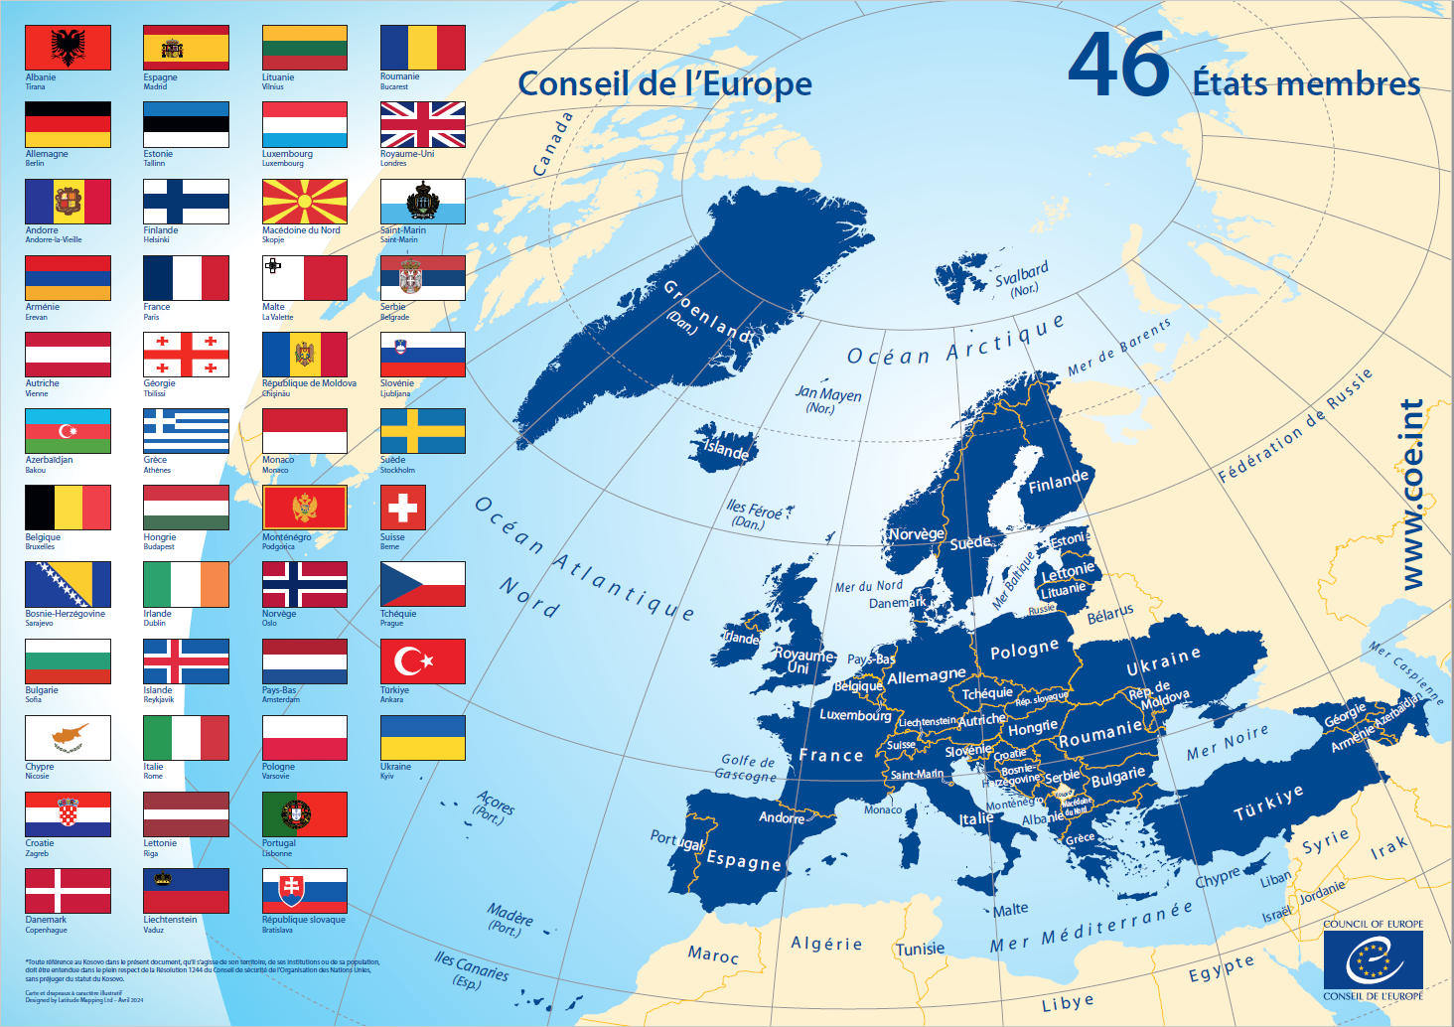
Thank you

